Slide 1
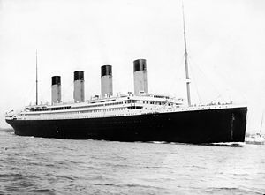
Titanic
Brenda Fleer
April 3, 2013
Language Arts 1-2

Slide 2
Millionaire’s Special
The Unsinkable
The Wonder Ship

Slide 3
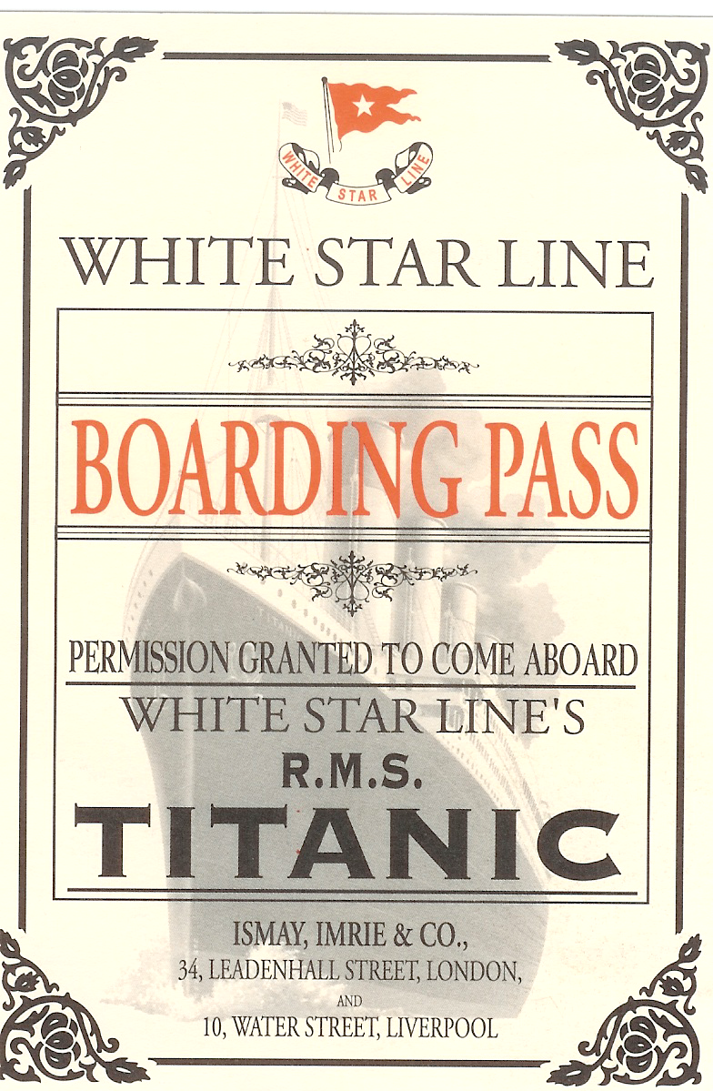
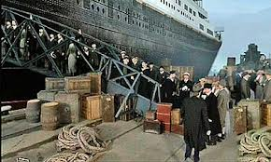
2,200 Passengers & Crew 1st, 2nd, 3rd Class

Slide 4
New York
Wednesday, April 10, 1912
Southampton, England

Slide 5
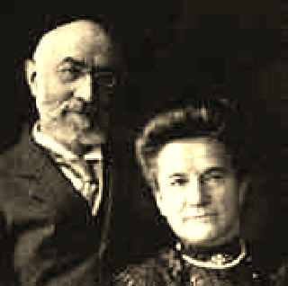
Isador & Ida Straus
Macy’s Department Store

Slide 6
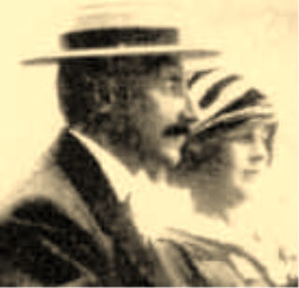
John Jacob Astor
&
Madeline
Wealthiest
Controversy

Slide 7
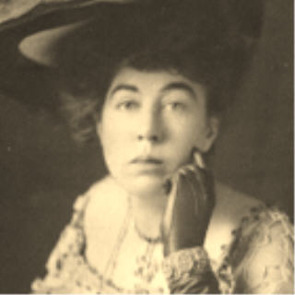
The “Unsinkable” Molly Brown
“New Money”

Slide 8
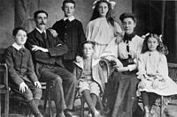
The Goodwin Family

Slide 9
Trip Began smoothly
7 iceberg warnings
“FULL SPEED AHEAD”

Slide 10
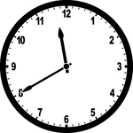

Slide 11
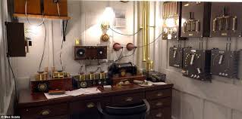
Distress signals sent
Ignored by Californian

Slide 12
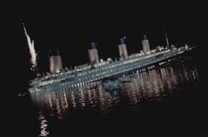
Closest ship--too late

Slide 13
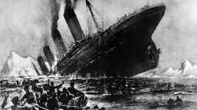
2:05 a.m.—April 15, 1912
Plunged to its death
Over half still on board

Slide 14
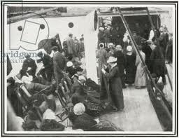
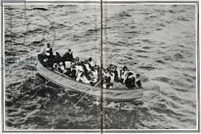
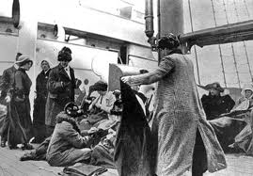
705 Survivors
398 bodies recovered

Slide 15
Natural Disaster
Or
Human Error?

Slide 16
BOTH!

Slide 17
Nicknames
precautions ignored
Water-tight compartments
Ignored iceberg warnings
Not enough lifeboats
No lifeboat drills
Lifeboats not filled to capacity

Slide 18
MAJOR CHANGES
New Laws—
Lifeboats
Safe speeds
Communication systems—
Including International Iceberg Patrol

Slide 19
Nothing is infallible!

